Slide 1
CMP 325
OBJECT-ORIENTED PROGRAMMING - JAVA

Slide 2
About the Java Technology
Java technology is both a programming language and a platform.
The Java Programming Language
The Java programming language is a high-level language that can be characterized by all of the following buzzwords:

Slide 3
Simple
Object oriented
Distributed
Multithreaded
Dynamic
Architecture neutral
Portable
High performance
Robust
Secure

Slide 4
Beginnings of the Java TM Programming Language Project
The Java TM programming language is designed to meet the challenges of application development in the context of heterogeneous, network-wide distributed environments. Paramount among these challenges is secure delivery of applications that consume the minimum of system resources, can run on any hardware and software platform, and can be extended dynamically.
The Java programming language originated as part of a research project to develop advanced software for a wide variety of network devices and embedded systems. The goal was to develop a small, reliable, portable, distributed, real-time operating platform. When the project started, C++ was the language of choice. But over time the difficulties encountered with C++ grew to the point where the problems could best be addressed by creating an entirely new language platform. Design and architecture decisions drew from a variety of languages such as Eiffel, SmallTalk, Objective C, and Cedar/Mesa. The result is a language platform that has proven ideal for developing secure, distributed, network-based end-user applications in environments ranging from network-embedded devices to the World-Wide Web and the desktop.

Slide 5
Design Goals of the Java TM Programming Language
The design requirements of the Java TM programming language are driven by the nature of the computing environments in which software must be deployed.
The massive growth of the Internet and the World-Wide Web leads us to a completely new way of looking at development and distribution of software. To live in the world of electronic commerce and distribution, Java technology must enable the development of secure, high performance, and highly robust applications on multiple platforms in heterogeneous, distributed networks.
Operating on multiple platforms in heterogeneous networks invalidates the traditional schemes of binary distribution, release, upgrade, patch, and so on. To survive in this jungle, the Java programming language must be architecture neutral, portable, and dynamically adaptable.

Slide 6
The system that emerged to meet these needs is simple, so it can be easily programmed by most developers; familiar, so that current developers can easily learn the Java programming language; object oriented, to take advantage of modern software development methodologies and to fit into distributed client-server applications; multithreaded, for high performance in applications that need to perform multiple concurrent activities, such as multimedia; and interpreted, for maximum portability and dynamic capabilities.
Together, the above requirements comprise quite a collection of buzzwords, so let's examine some of them and their respective benefits before going on.

Slide 7
Simple, Object Oriented, and Familiar
Primary characteristics of the Java programming language include a simple language that can be programmed without extensive programmer training while being attuned to current software practices. The fundamental concepts of Java technology are grasped quickly; programmers can be productive from the very beginning.
The Java programming language is designed to be object oriented from the ground up. Object technology has finally found its way into the programming mainstream after a gestation period of thirty years. The needs of distributed, client-server based systems coincide with the encapsulated, message-passing paradigms of object-based software. To function within increasingly complex, network-based environments, programming systems must adopt object-oriented concepts. Java technology provides a clean and efficient object-based development platform.

Slide 8
Programmers using the Java programming language can access existing libraries of tested objects that provide functionality, ranging from basic data types, through I/O and network interfaces to graphical user interface toolkits. These libraries can be extended to provide new behaviour.
Even though C++ was rejected as an implementation language, keeping the Java programming language looking like C++ as far as possible results in it being a familiar language, while removing the unnecessary complexities of C++. Having the Java programming language retain many of the object-oriented features and the "look and feel" of C++ means that programmers can migrate easily to the Java platform and be productive quickly.

Slide 9
Robust and Secure
The Java programming language is designed for creating highly reliable software. It provides extensive compile-time checking, followed by a second level of run-time checking. Language features guide programmers towards reliable programming habits.
The memory management model is extremely simple: objects are created with a new operator. There are no explicit programmer-defined pointer data types, no pointer arithmetic, and automatic garbage collection. This simple memory management model eliminates entire classes of programming errors that bedevil C and C++ programmers. You can develop Java code with confidence that the system will find many errors quickly and that major problems won't lay dormant until after your production code has shipped.
Java technology is designed to operate in distributed environments, which means that security is of paramount importance. With security features designed into the language and run-time system, Java technology lets you construct applications that can't be invaded from outside. In the network environment, applications written in the Java programming language are secure from intrusion by unauthorized code attempting to get behind the scenes and create viruses or invade file systems.

Slide 10
Architecture Neutral and Portable
Java technology is designed to support applications that will be deployed into heterogeneous network environments. In such environments, applications must be capable of executing on a variety of hardware architectures. Within this variety of hardware platforms, applications must execute atop a variety of operating systems and interoperate with multiple programming language interfaces. To accommodate the diversity of operating environments, the Java Compiler TM product generates bytecodes--an architecture neutral intermediate format designed to transport code efficiently to multiple hardware and software platforms. The interpreted nature of Java technology solves both the binary distribution problem and the version problem; the same Java programming language byte codes will run on any platform.

Slide 11
Architecture neutrality is just one part of a truly portable system. Java technology takes portability a stage further by being strict in its definition of the basic language. Java technology puts a stake in the ground and specifies the sizes of its basic data types and the behaviour of its arithmetic operators. Your programs are the same on every platform--there are no data type incompatibilities across hardware and software architectures.
The architecture-neutral and portable language platform of Java technology is known as the Java virtual machine. It's the specification of an abstract machine for which Java programming language compilers can generate code. Specific implementations of the Java virtual machine for specific hardware and software platforms then provide the concrete realization of the virtual machine. The Java virtual machine is based primarily on the POSIX interface specification--an industry-standard definition of a portable system interface. Implementing the Java virtual machine on new architectures is a relatively straightforward task as long as the target platform meets basic requirements such as support for multithreading.

Slide 12
High Performance
Performance is always a consideration. The Java platform achieves superior performance by adopting a scheme by which the interpreter can run at full speed without needing to check the run-time environment. The automatic garbage collector runs as a low-priority background thread, ensuring a high probability that memory is available when required, leading to better performance. Applications requiring large amounts of compute power can be designed such that compute-intensive sections can be rewritten in native machine code as required and interfaced with the Java platform. In general, users perceive that interactive applications respond quickly even though they're interpreted.

Slide 13
Interpreted, Threaded, and Dynamic
The Java interpreter can execute Java bytecodes directly on any machine to which the interpreter and run-time system have been ported. In an interpreted platform such as Java technology-based system, the link phase of a program is simple, incremental, and lightweight. You benefit from much faster development cycles--prototyping, experimentation, and rapid development are the normal case, versus the traditional heavyweight compile, link, and test cycles.
Modern network-based applications, such as the HotJava TM Browser for the World Wide Web, typically need to do several things at the same time. A user working with HotJava Browser can run several animations concurrently while downloading an image and scrolling the page. Java technology's multithreading capability provides the means to build applications with many concurrent threads of activity. Multithreading thus results in a high degree of interactivity for the end user.

Slide 14
The Java platform supports multithreading at the language level with the addition of sophisticated synchronization primitives: the language library provides the Thread class, and the run-time system provides monitor and condition lock primitives. At the library level, moreover, Java technology's high-level system libraries have been written to be thread safe: the functionality provided by the libraries is available without conflict to multiple concurrent threads of execution.
While the Java Compiler is strict in its compile-time static checking, the language and run-time system are dynamic in their linking stages. Classes are linked only as needed. New code modules can be linked in on demand from a variety of sources, even from sources across a network. In the case of the HotJava Browser and similar applications, interactive executable code can be loaded from anywhere, which enables transparent updating of applications. The result is on-line services that constantly evolve; they can remain innovative and fresh, draw more customers, and spur the growth of electronic commerce on the Internet.

Slide 15
The Java Platform--a New Approach to Distributed Computing
Taken individually, the characteristics discussed above can be found in a variety of software development platforms. What's completely new is the manner in which Java technology and its runtime environment have combined them to produce a flexible and powerful programming system.
Developing your applications using the Java programming language results in software that is portable across multiple machine architectures, operating systems, and graphical user interfaces, secure, and high performance. With Java technology, your job as a software developer is much easier--you focus your full attention on the end goal of shipping innovative products on time, based on the solid foundation of the Java platform. The better way to develop software is here, now, brought to you by the Java platform.

Slide 16
In the Java programming language, all source code is first written in plain text files ending with the .java extension. Those source files are then compiled into .class files by the javac compiler. A .class file does not contain code that is native to your processor; it instead contains bytecodes — the machine language of the Java Virtual Machine¹ (Java VM). The java launcher tool then runs your application with an instance of the Java Virtual Machine.

Slide 17
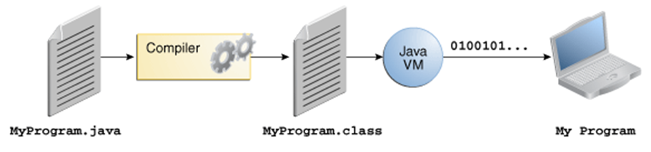
An overview of the software development process.

Slide 18
Because the Java VM is available on many different operating systems, the same .class files are capable of running on Microsoft Windows, the Solaris™ Operating System (Solaris OS), Linux, or Mac OS. Some virtual machines, such as the Java SE HotSpot at a Glance, perform additional steps at runtime to give your application a performance boost. This includes various tasks such as finding performance bottlenecks and recompiling (to native code) frequently used sections of code.

Slide 19
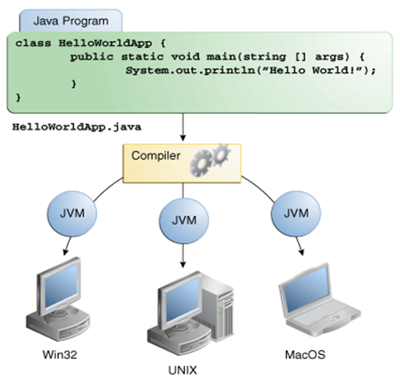
Through the Java VM, the same application is capable of running on multiple platforms.

Slide 20
The Java Platform
A platform is the hardware or software environment in which a program runs. We've already mentioned some of the most popular platforms like Microsoft Windows, Linux, Solaris OS, and Mac OS. Most platforms can be described as a combination of the operating system and underlying hardware. The Java platform differs from most other platforms in that it's a software-only platform that runs on top of other hardware-based platforms.
The Java platform has two components:
The Java Virtual Machine
The Java Application Programming Interface (API)

Slide 21
You've already been introduced to the Java Virtual Machine; it's the base for the Java platform and is ported onto various hardware-based platforms.
The API is a large collection of ready-made software components that provide many useful capabilities. It is grouped into libraries of related classes and interfaces; these libraries are known as packages.

Slide 23
What Java Technology Can Do
The general-purpose, high-level Java programming language is a powerful software platform. Every full implementation of the Java platform gives you the following features:
Development Tools: The development tools provide everything you'll need for compiling, running, monitoring, debugging, and documenting your applications. As a new developer, the main tools you'll be using are the javac compiler, the java launcher, and the javadoc documentation tool.
. Application Programming Interface (API): The API provides the core functionality of the Java programming language. It offers a wide array of useful classes ready for use in your own applications. It spans everything from basic objects, to networking and security, to XML generation and database access, and more.

Slide 24
Deployment Technologies: The JDK software provides standard mechanisms such as the Java Web Start software and Java Plug-In software for deploying your applications to end users.
User Interface Toolkits: The JavaFX, Swing, and Java 2D toolkits make it possible to create sophisticated Graphical User Interfaces (GUIs).
Integration Libraries: Integration libraries such as the Java IDL API, JDBC API, Java Naming and Directory Interface (JNDI) API, Java RMI, and Java Remote Method Invocation over Internet Inter-ORB Protocol Technology (Java RMI-IIOP Technology) enable database access and manipulation of remote objects.

Slide 25
How Java Technology Can Change Life
You might not be promised fame, fortune, or even a job if you learn the Java programming language. Still, it is likely to make your programs better and requires less effort than other languages. It is believed that Java technology will help you do the following:
Get started quickly: Although the Java programming language is a powerful object-oriented language, it's easy to learn, especially for programmers already familiar with C or C++.
Write less code: Comparisons of program metrics (class counts, method counts, and so on) suggest that a program written in the Java programming language can be four times smaller than the same program written in C++.

Slide 26
Write better code: The Java programming language encourages good coding practices, and automatic garbage collection helps you avoid memory leaks. Its object orientation, its JavaBeans™ component architecture, and its wide-ranging, easily extendible API let you reuse existing, tested code and introduce fewer bugs.
Develop programs more quickly: The Java programming language is simpler than C++, and as such, your development time could be up to twice as fast when writing in it. Your programs will also require fewer lines of code.
Avoid platform dependencies: You can keep your program portable by avoiding the use of libraries written in other languages.
Write once, run anywhere: Because applications written in the Java programming language are compiled into machine-independent bytecodes, they run consistently on any Java platform.

Slide 27
Distribute software more easily: With Java Web Start software, users will be able to launch your applications with a single click of the mouse. An automatic version check at startup ensures that users are always up to date with the latest version of your software. If an update is available, the Java Web Start software will automatically update their installation.

Slide 28
Object-Oriented Programming Concepts
Object
Objects are key to understanding object-oriented technology. Look around right now and you'll find many examples of real-world objects: your dog, your desk, your television set, your bicycle.
Real-world objects share two characteristics: They all have state and behaviour. Dogs have state (name, colour, breed, hungry) and behaviour (barking, fetching, wagging tail). Bicycles also have state (current gear, current pedal cadence, current speed) and behaviour (changing gear, changing pedal cadence, applying brakes). Identifying the state and behaviour for real-world objects is a great way to begin thinking in terms of object-oriented programming.

Slide 29
Take a minute right now to observe the real-world objects that are in your immediate area. For each object that you see, ask yourself two questions: "What possible states can this object be in?" and "What possible behaviour can this object perform?". Make sure to write down your observations. As you do, you'll notice that real-world objects vary in complexity; your desktop lamp may have only two possible states (on and off) and two possible behaviours (turn on, turn off), but your desktop radio might have additional states (on, off, current volume, current station) and behaviour (turn on, turn off, increase volume, decrease volume, seek, scan, and tune). You may also notice that some objects, in turn, will also contain other objects. These real-world observations all translate into the world of object-oriented programming.

Slide 31
Software objects are conceptually similar to real-world objects: they too consist of state and related behaviour. An object stores its state in fields (variables in some programming languages) and exposes its behaviour through methods (functions in some programming languages). Methods operate on an object's internal state and serve as the primary mechanism for object-to-object communication. Hiding internal state and requiring all interaction to be performed through an object's methods is known as data encapsulation — a fundamental principle of object-oriented programming.

Slide 33
By attributing state (current speed, current pedal cadence, and current gear) and providing methods for changing that state, the object remains in control of how the outside world is allowed to use it. For example, if the bicycle only has 6 gears, a method to change gears could reject any value that is less than 1 or greater than 6.
Bundling code into individual software objects provides a number of benefits, including:
Modularity: The source code for an object can be written and maintained independently of the source code for other objects. Once created, an object can be easily passed around inside the system.
Information-hiding: By interacting only with an object's methods, the details of its internal implementation remain hidden from the outside world.

Slide 34
3. Code re-use: If an object already exists (perhaps written by another software developer), you can use that object in your program. This allows specialists to implement/test/debug complex, task-specific objects, which you can then trust to run in your own code.
4. Pluggability and debugging ease: If a particular object turns out to be problematic, you can simply remove it from your application and plug in a different object as its replacement. This is analogous to fixing mechanical problems in the real world. If a bolt breaks, you replace it, not the entire machine.

Slide 35
Class
In the real world, you'll often find many individual objects all of the same kind. There may be thousands of other bicycles in existence, all of the same make and model. Each bicycle was built from the same set of blueprints and therefore contains the same components. In object-oriented terms, we say that your bicycle is an instance of the class of objects known as bicycles. A class is the blueprint from which individual objects are created.

Slide 36
The following Bicycle class is one possible implementation of a bicycle:
class Bicycle {
int cadence = 0;
int speed = 0;
int gear = 1;
void changeCadence(int newValue) {
cadence = newValue;
}
void changeGear(int newValue) {
gear = newValue;
}
void speedUp(int increment) {
speed = speed + increment;
}
void applyBrakes(int decrement) {
speed = speed - decrement;
}
void printStates() {
System.out.println("cadence:" +
cadence + " speed:" +
speed + " gear:" + gear);
}
}

Slide 37
The syntax of the Java programming language will look new to you, but the design of this class is based on the previous discussion of bicycle objects. The fields cadence, speed, and gear represent the object's state, and the methods (changeCadence, changeGear, speedUp etc.) define its interaction with the outside world.
You may have noticed that the Bicycle class does not contain a main method. That's because it's not a complete application; it's just the blueprint for bicycles that might be used in an application. The responsibility of creating and using new Bicycle objects belongs to some other class in your application.
Here's a BicycleDemo class that creates two separate Bicycle objects and invokes their methods:

Slide 38
class BicycleDemo {
public static void main(String[] args) {
// Create two different
// Bicycle objects
Bicycle bike1 = new Bicycle();
Bicycle bike2 = new Bicycle();
// Invoke methods on
// those objects
bike1.changeCadence(50);
bike1.speedUp(10);
bike1.changeGear(2);
bike1.printStates();
bike2.changeCadence(50);
bike2.speedUp(10);
bike2.changeGear(2);
bike2.changeCadence(40);
bike2.speedUp(10);
bike2.changeGear(3);
bike2.printStates();
}
}

Slide 39
The output of this test prints the ending pedal cadence, speed, and gear for the two bicycles:
cadence:50 speed:10 gear:2
cadence:40 speed:20 gear:3

Slide 40
Inheritance
Different kinds of objects often have a certain amount in common with each other. Mountain bikes, road bikes, and tandem bikes, for example, all share the characteristics of bicycles (current speed, current pedal cadence, current gear). Yet each also defines additional features that make them different: tandem bicycles have two seats and two sets of handlebars; road bikes have drop handlebars; some mountain bikes have an additional chain ring, giving them a lower gear ratio.
Object-oriented programming allows classes to inherit commonly used state and behaviour from other classes. In this example, Bicycle now becomes the superclass of MountainBike, RoadBike, and TandemBike. In the Java programming language, each class is allowed to have one direct superclass, and each superclass has the potential for an unlimited number of subclasses:

Slide 41
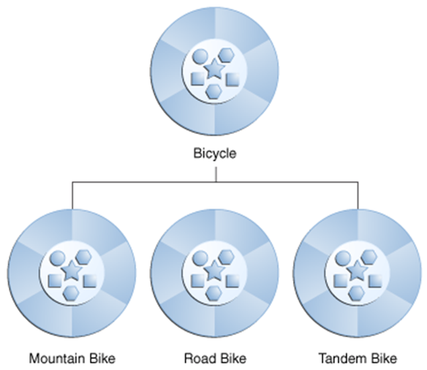
A hierarchy of bicycle classes.

Slide 42
The syntax for creating a subclass is simple. At the beginning of your class declaration, use the extends keyword, followed by the name of the class to inherit from:
class MountainBike extends Bicycle {
// new fields and methods defining
// a mountain bike would go here
}
This gives MountainBike all the same fields and methods as Bicycle, yet allows its code to focus exclusively on the features that make it unique. This makes code for your subclasses easy to read. However, you must take care to properly document the state and behaviour that each superclass defines, since that code will not appear in the source file of each subclass.

Slide 43
Interface
As you've already learned, objects define their interaction with the outside world through the methods that they expose. Methods form the object's interface with the outside world; the buttons on the front of your television set, for example, are the interface between you and the electrical wiring on the other side of its plastic casing. You press the "power" button to turn the television on and off.
In its most common form, an interface is a group of related methods with empty bodies. A bicycle's behaviour, if specified as an interface, might appear as follows:

Slide 44
interface Bicycle {
// wheel revolutions per minute
void changeCadence(int newValue);
void changeGear(int newValue);
void speedUp(int increment);
void applyBrakes(int decrement);
}
To implement this interface, the name of your class would change (to a particular brand of bicycle, for example, such as ACMEBicycle), and you'd use the implements keyword in the class declaration:

Slide 45
class ACMEBicycle implements Bicycle {
int cadence = 0;
int speed = 0;
int gear = 1;
// The compiler will now require that methods
// changeCadence, changeGear, speedUp, and applyBrakes
// all be implemented. Compilation will fail if those
// methods are missing from this class.
void changeCadence(int newValue) {
cadence = newValue;
}
void changeGear(int newValue) {
gear = newValue;
}
void speedUp(int increment) {
speed = speed + increment;
}
void applyBrakes(int decrement) {
speed = speed - decrement;
}
void printStates() {
System.out.println("cadence:" +
cadence + " speed:" +
speed + " gear:" + gear);
}
}

Slide 46
Implementing an interface allows a class to become more formal about the behaviour it promises to provide. Interfaces form a contract between the class and the outside world, and this contract is enforced at build time by the compiler. If your class claims to implement an interface, all methods defined by that interface must appear in its source code before the class will successfully compile.
Note: To actually compile the ACMEBicycle class, you'll need to add the public keyword to the beginning of the implemented interface methods.

Slide 47
Package
A package is a namespace that organizes a set of related classes and interfaces. Conceptually you can think of packages as being similar to different folders on your computer. You might keep HTML pages in one folder, images in another, and scripts or applications in yet another. Because software written in the Java programming language can be composed of hundreds or thousands of individual classes, it makes sense to keep things organized by placing related classes and interfaces into packages.
The Java platform provides an enormous class library (a set of packages) suitable for use in your own applications. This library is known as the "Application Programming Interface", or "API" for short. Its packages represent the tasks most commonly associated with general-purpose programming.

Slide 48
For example, a String object contains state and behaviour for character strings; a File object allows a programmer to easily create, delete, inspect, compare, or modify a file on the filesystem; a Socket object allows for the creation and use of network sockets; various GUI objects control buttons and checkboxes and anything else related to graphical user interfaces. There are literally thousands of classes to choose from. This allows you, the programmer, to focus on the design of your particular application, rather than the infrastructure required to make it work.
The Java Platform API Specification contains the complete listing for all packages, interfaces, classes, fields, and methods supplied by the Java SE platform. Load the page in your browser and bookmark it. As a programmer, it will become your single most important piece of reference documentation.

Slide 49
Polymorphism
Polymorphism is a OOPs concept where one name can have many forms.
For example, you have a smartphone for communication. The communication mode you choose could be anything. It can be a call, a text message, a picture message, mail, etc. So, the goal is common that is communication, but their approach is different. This is called Polymorphism.
Java Polymorphism in OOP’s with Example
We have one parent class, ‘Account’ with function of deposit and withdraw. Account has 2 child classes
The operation of deposit and withdraw is same for Saving and Checking accounts. So the inherited methods from Account class will work.

Slide 50
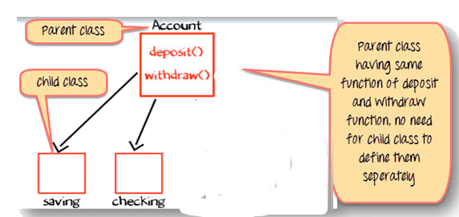
Change in Software Requirement
There is a change in the requirement specification, something that is so common in the software industry. You are supposed to add functionality privileged Banking Account with Overdraft Facility.
For a background, overdraft is a facility where you can withdraw an amount more than the available balance in your account.
So, withdraw method for privileged needs is to be implemented afresh. But you do not change the tested piece of code in Savings and Checking account. This is advantage of OOPS.

Slide 51
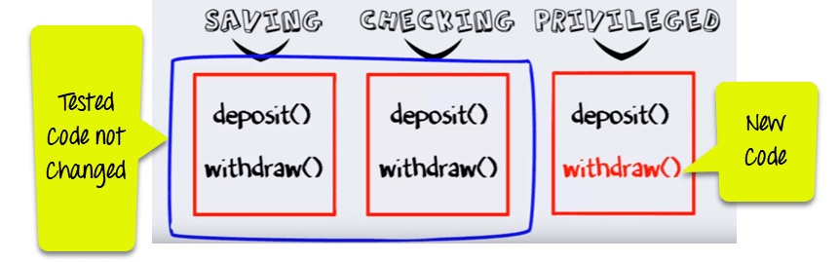
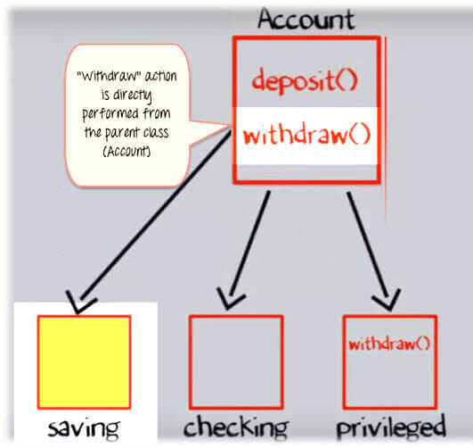
Step 1) Such that when the "withdrawn" method for saving account is called a method from parent account class is executed.
Step 2) But when the "Withdraw" method for the privileged account (overdraft facility) is called withdraw method defined in the privileged class is executed. This is Polymorphism.

Slide 52
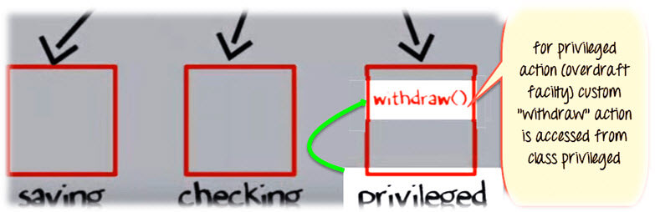
Method Overriding
Method Overriding is redefining a super class method in a sub class.
Rules for Method Overriding
The method signature i.e. method name, parameter list and return type have to match exactly.
The overridden method can widen the accessibility but not narrow it, i.e. if it is private in the base class, the child class can make it public but not vice versa.

Slide 53
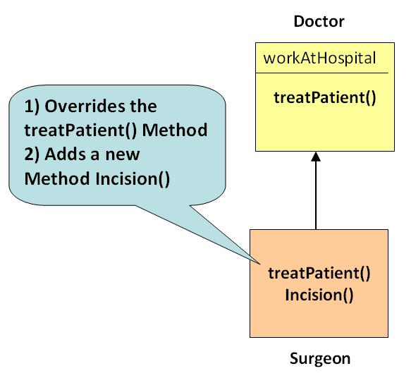

Slide 54
Example
class Doctor{
public void treatPatient(){
// treatPatient method
}
class Surgeon extends Doctor{
public void treatPatient(){
// treatPatient method
}
}
Class run{
public static void main (String args[]){
Doctor doctorObj = new Doctor()
// treatPatient method in class Doctor will be executed
doctorObj.treatPatient();
Surgeon surgeonObj = new Surgeon();
// treatPatient method in class Surgeon will be executed
surgeonObj.treatPatient();
}
}

Slide 56
What is Dynamic Polymorphism?
Dynamic Polymorphism is the mechanism by which multiple methods can be defined with same name and signature in the superclass and subclass. The call to an overridden method are resolved at run time.
Dynamic Polymorphism Example:
A reference variable of the super class can refer to a sub class object
Doctor obj = new Surgeon();
Consider the statement
obj.treatPatient();
Here the reference variable "obj" is of the parent class, but the object it is pointing to is of the child class (as shown in the diagram).

Slide 57
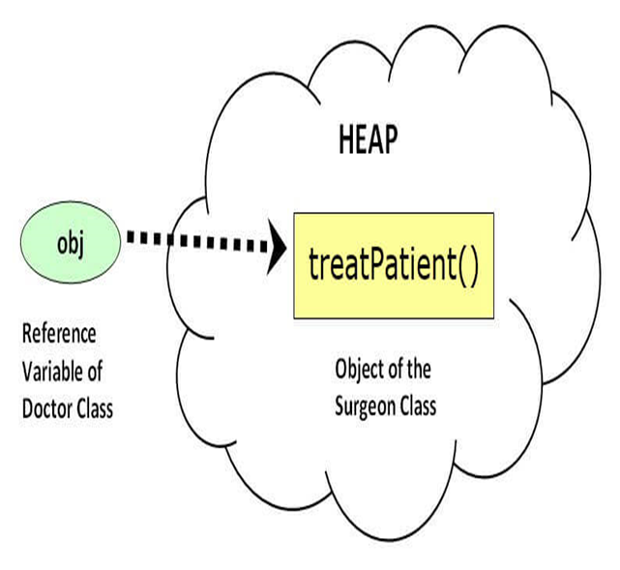

Slide 58
obj.treatPatient() will execute treatPatient() method of the sub-class - Surgeon
If a base class reference is used to call a method, the method to be invoked is decided by the JVM, depending on the object the reference is pointing to
For example, even though obj is a reference to Doctor, it calls the method of Surgeon, as it points to a Surgeon object
This is decided during run-time and hence termed dynamic or run-time polymorphism
Super Keyword
What if the treatPatient method in the Surgeon class wants to execute the functionality defined in Doctor class and then perform its own specific functionality? In this case, keyword super can be used to access methods of the parent class from the child class. The treatPatient method in the Surgeon class could be written as:

Slide 59
treatPatient(){
super.treatPatient();
//add code specific to Surgeon
}
The keyword super can be used to access any data member or methods of the super class in the sub class. Example:-To learn Inheritance, Polymorphism & super keyword

Slide 60
Step 1) Copy the following code into an Editor
public class Test{
public static void main(String args[]){
X x= new X();
Y y = new Y();
y.m2();
//x.m1();
//y.m1();
//x = y;// parent pointing to object of child
//x.m1() ;
//y.a=10;
}
}

Slide 61
class X{
private int a;
int b;
public void m1(){
System.out.println("This is method m1 of class X");
}
}
class Y extends X{
int c; // new instance variable of class Y
public void m1(){
// overriden method
System.out.println("This is method m1 of class Y");
}
public void m2(){
super.m1();
System.out.println("This is method m2 of class Y");
}
}

Slide 62
Step 2) Save, Compile & Run the code. Observe the output. Step 3) Uncomments lines # 6-9. Save, Compile & Run the code. Observe the output. Step 4) Uncomment line # 10 . Save & Compile the code. Step 5) Error = ? This is because sub-class cannot access private members of the super class.
Difference between Static & Dynamic Polymorphism
Static Polymorphism | Dynamic Polymorphism
It relates to method overloading. | It relates to method overriding.
Errors, if any, are resolved at compile time. Since the code is not executed during compilation, hence the name static. Ex: void sum (int a , int b); void sum (float a, double b); int sum (int a, int b); //compiler gives error. | In case a reference variable is calling an overridden method, the method to be invoked is determined by the object, your reference variable is pointing to. This is can be only determined at runtime when code in under execution, hence the name dynamic. Ex: //reference of parent pointing to child object Doctor obj = new Surgeon(); // method of child called obj.treatPatient();

Slide 63
Abstraction in OOP
Abstraction is selecting data from a larger pool to show only the relevant details to the object. It helps to reduce programming complexity and effort. In Java, abstraction is accomplished using Abstract classes and interfaces. It is one of the most important concepts of OOPs.
Abstraction concept with an Example
Suppose you want to create a banking application and you are asked to collect all the information about your customer. There are chances that you will come up with following information about the customer

Slide 64
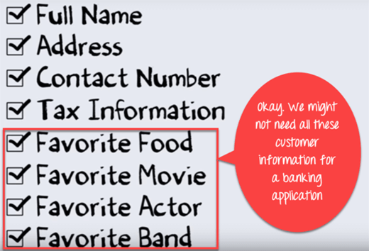
But, not all of the above information is required to create a banking application.
So, you need to select only the useful information for your banking application from that pool. Data like name, address, tax information, etc. make sense for a banking application.

Slide 65
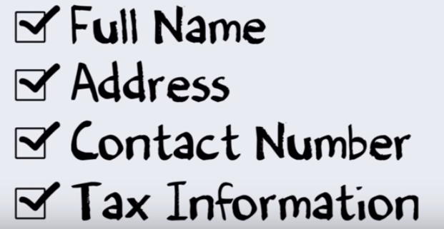
Since we have fetched/removed/selected the customer information from a larger pool, the process is referred as Abstraction.

Slide 66
However, the same information once extracted can be used for a wide range of applications. For instance, you can use the same data for hospital application, job portal application, a Government database, etc. with little or no modification. Hence, it becomes your Master Data. This is an advantage of Abstraction.
How to achieve Abstraction
Abstraction in Java can be achieved using Abstract Class and Abstract Method.
Abstract Class
A class which is declared “abstract” is called as an abstract class. It can have abstract methods as well as concrete methods. A normal class cannot have abstract methods.
Abstract Method
A method without a body is known as an Abstract Method. It must be declared in an abstract class. The abstract method will never be final because the abstract class must implement all the abstract methods.

Slide 67
Rules of Abstract Method
Abstract methods do not have an implementation; it only has method signature
If a class is using an abstract method they must be declared abstract. The opposite cannot be true. This means that an abstract class does not necessarily have an abstract method.
If a regular class extends an abstract class, then that class must implement all the abstract methods of the abstract parent.

Slide 68
Advantages of Abstraction
The main benefit of using an abstract class is that it allows you to group several related classes as siblings.
Abstraction helps to reduce the complexity of the design and implementation process of software.
When to use Abstract Methods & Abstract Class
Abstract methods are mostly declared where two or more subclasses are also doing the same thing in different ways through different implementations. It also extends the same Abstract class and offers different implementations of the abstract methods.
Abstract classes help to describe generic types of behaviours and object-oriented programming class hierarchy. It also describes subclasses to offer implementation details of the abstract

Slide 69
Encapsulation in Java OOPs
Encapsulation is a principle of wrapping data (variables) and code together as a single unit. It is one of the four OOP concepts. The other three are Inheritance, Polymorphism, and Abstraction.
To understand what is encapsulation in detail consider the following bank account class with deposit and show balance methods
class Account {
private int account_number;
private int account_balance;
public void show Data() {
//code to show data
}
public void deposit(int a) {
if (a < 0) {
//show error
} else
account_balance = account_balance + a;
}
}

Slide 70

Suppose a hacker managed to gain access to the code of your bank account. Now, he tries to deposit amount -100 into your account by two ways. Let see his first method or approach.
Approach 1: He tries to deposit an invalid amount (say -100) into your bank account by manipulating the code.

Slide 71
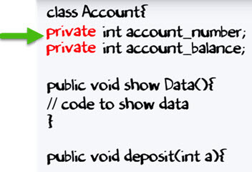
Now, the question is – Is that possible? Let investigate.
Usually, a variable in a class are set as "private" as shown below. It can only be accessed with the methods defined in the class. No other class or object can access them.

Slide 72
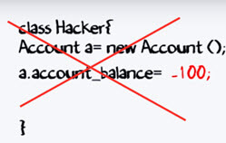
If a data member is private, it means it can only be accessed within the same class. No outside class can access private data member or variable of other class.
So in our case hacker cannot deposit amount -100 to your account.

Slide 73
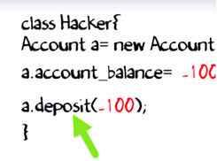
Approach 2: Hacker's first approach failed to deposit the amount. Next, he tries to do deposit a amount -100 by using "deposit" method.

Slide 74
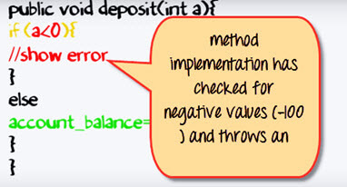
But method implementation has a check for negative values. So the second approach also fails.
Thus, you never expose your data to an external party. Which makes your application secure.

Slide 75
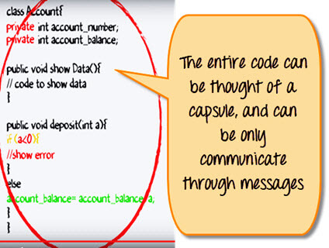
The entire code can be thought of as a capsule, and you can only communicate through the messages. Hence the name encapsulation.

Slide 76
Data Hiding in Java
Frequently, Java encapsulation is referred as data hiding. But more than data hiding, encapsulation concept is meant for better management or grouping of related data.
To achieve a lesser degree of encapsulation in Java, you can use modifiers like "protected" or "public". With encapsulation, developers can change one part of the code easily without affecting other.

Slide 77
Advantages of Encapsulation in Java
Encapsulation is binding the data with its related functionalities. Here functionalities mean "methods" and data means "variables"
So we keep variable and methods in one place. That place is "class." Class is the base for encapsulation.
With Java Encapsulation, you can hide (restrict access) to critical data members in your code, which improves security
As we discussed earlier, if a data member is declared "private", then it can only be accessed within the same class. No outside class can access data member (variable) of other class.
However, if you need to access these variables, you have to use public "getter" and "setter" methods.

Slide 78
Getter and Setter Methods in Java
If a data member is declared "private", then it can only be accessed within the same class. No outside class can access data member of that class. If you need to access these variables, you have to use public "getter" and "setter" methods.
Getter and Setter's methods are used to create, modify, delete and view the variables values.
The following code is an example of getter and setter methods:
class Account{
private int account_number;
private int account_balance;
// getter method
public int getBalance() {
return this.account_balance;
}
// setter method
public void setNumber(int num) {
this.account_number = num;
}
}

Slide 79
In above example, getBalance() method is getter method that reads value of variable account_balance and setNumber() method is setter method that sets or update value for variable account_number.
Abstraction vs. Encapsulation
Often encapsulation is misunderstood with Abstraction. Lets study-
Encapsulation is more about "How" to achieve a functionality
Abstraction is more about "What" a class can do.
A simple example to understand this difference is a mobile phone. Where the complex logic in the circuit board is encapsulated in a touch screen, and the interface is provided to abstract it out.

Slide 80
Java Variables and Data Types
What is a Variable?
A variable can be thought of as a container which holds value for you, during the life of a Java program. Every variable is assigned a data type which designates the type and quantity of value it can hold.
In order to use a variable in a program you to need to perform 2 steps
Variable Declaration
Variable Initialization

Slide 81
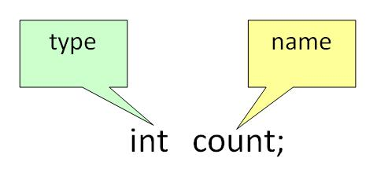
Variable Declaration:
To declare a variable, you must specify the data type & give the variable a unique name.

Slide 82
Examples of other Valid Declarations are
int a,b,c;
float pi;
double d;
char a;
Variable Initialization:
To initialize a variable, you must assign it a valid value.

Slide 83
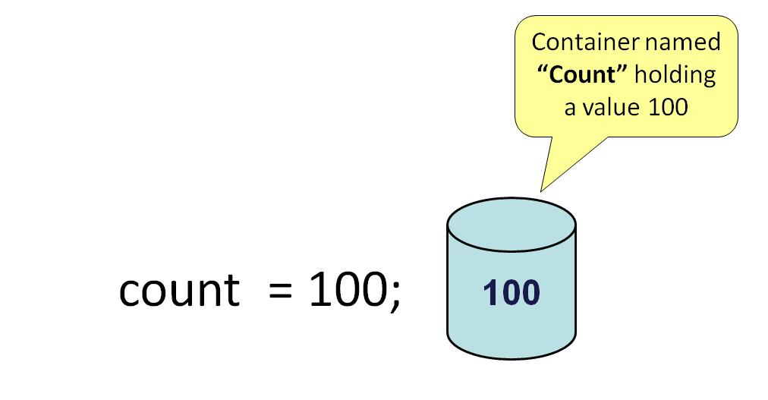
Example of other Valid Initializations are
pi =3.14f;
do =20.22d;
a=’v’;

Slide 84

You can combine variable declaration and initialization.
Example :
int a=2,b=4,c=6;
float pi=3.14f;
double do=20.22d;
char a=’v’;

Slide 85
Types of variables
In Java, there are three types of variables:
Local Variables
Instance Variables
Static Variables
1) Local Variables
Local Variables are a variable that are declared inside the body of a method.
2) Instance Variables
Instance variables are defined without the STATIC keyword .They are defined Outside a method declaration. They are Object specific and are known as instance variables.
3) Static Variables
Static variables are initialized only once, at the start of the program execution. These variables should be initialized first, before the initialization of any instance variables.

Slide 86
Example: Types of Variables in Java
class Guru99 {
int data = 99; //instance variable
static int a = 1; //static variable
void method() {
int b = 90; //local variable
}
}.

Slide 87
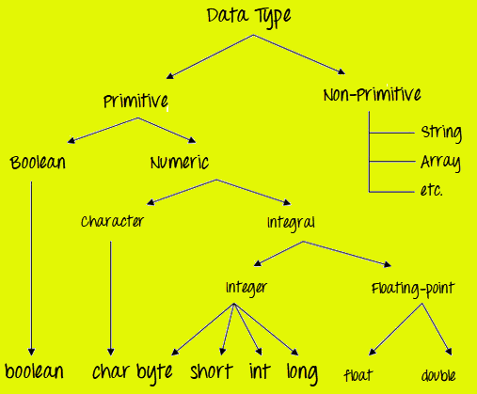
Data Types in Java
Data types classify the different values to be stored in the variable. In java, there are two types of data types:
Primitive Data Types
Non-primitive Data Types

Slide 88
Primitive Data Types
Primitive Data Types are predefined and available within the Java language. Primitive values do not share state with other primitive values.
There are 8 primitive types: byte, short, int, long, char, float, double, and boolean Integer data types
byte (1 byte)
short (2 bytes)
int (4 bytes)
long (8 bytes)

Slide 89
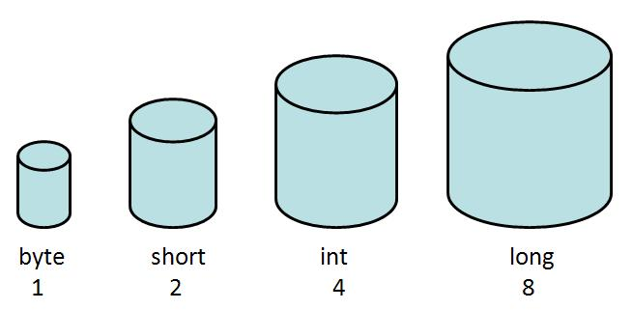
Floating Data Type
float (4 bytes)
double (8 bytes)
Textual Data Type
char (2 bytes)
Logical
boolean (1 byte) (true/false)

Slide 90
Java Data Types
Data Type | Default Value | Default size
byte | 0 | 1 byte
short | 0 | 2 bytes
int | 0 | 4 bytes
long | 0L | 8 bytes
float | 0.0f | 4 bytes
double | 0.0d | 8 bytes
boolean | false | 1 bit
char | '\u0000' | 2 bytes

Slide 91
Points to Remember:
All numeric data types are signed(+/-).
The size of data types remain the same on all platforms (standardized)
char data type in Java is 2 bytes because it uses UNICODE character set. By virtue of it, Java supports internationalization. UNICODE is a character set which covers all known scripts and language in the world

